Slide 1
Can an online program be a critical resource for collaborative divorces?
Irwin Sandler, Michele Porter, Sharlene
Wolchik, Jenn Yun-Tein
Contact: irwin.sandler@asu.edu
DISCLOSURE
conflict of interest: Sandler, Wolchik & Porter are marketing online New Beginnings through our LLC Family Transitions-Programs that Work

Slide 2
Team of Collaborators and Support of the Eunice Kennedy Shriver National Institute of Child Health and Human Development (NICHD R01HD094334)
Sharlene Wolchik
Michele Porter
Emily Winslow
Jenn Yun-Tein
Karey O’Hara

Slide 3
Presentation Overview
Complimentary pathways to better divorces: Science and Collaborative Systems
Quiet revolution in parent training
Translation of New Beginnings Program (NBP) to an online format (eNBP)
Example of how we teach interparental conflict reduction skills
Does it work? What’s the evidence?
Implications for sustainable use of eNBP
How can this make a difference for collaborative law focused services for divorcing families

Slide 4
Science and Systems as Complementary Pathways to Better Divorces
Science
What factors matter
Evidence that we can change what matters
Better Divorce Outcomes for Children
and Parents
System
Non-adversarial Collaborative System

Slide 5
Scientific Pathway 1: Understanding “What Matters” will lead to better divorces
Based on the belief that if we only “understood” what matters we would naturally improve divorce outcomes for children
40 years of research (Sandler, Wolchik, Porter, Braver, Cookston et al.) identified multiple things that matter for child outcomes
Stressors of divorce
Father involvement
Quality of post-divorce parenting by fathers and mothers
Interparental conflict
Combination of interparental conflict and quality of parenting
We learned A LOT – OVER 100 SCIENTIFIC PUBLICATIONS!

Slide 6
Scientific Pathway 2: Scientifically Development of Programs to Improve “What Matters” will lead to better divorces
Based on the belief that if we have evidence that we improve what matters it will lead to better divorces
What we have learned
Scientific evidence that a program that changes “what matters most” does indeed significantly improve the long-term well-being of children following divorce
Scientific evidence that the program can be made feasible, acceptable and cheap
But – “If we build it the DO NOT COME”
Need to collaborate with systems to translate science into actual impact on divorced families in the real world
Opportunity – collaboration with better divorce systems (Collaborative Law) to have actual impact on divorcing families in the “real world”

Slide 7
Our Research Journey to an On-line Evidence Based New Beginnings Program
New Beginnings Program (NBP): In-Person Group Program for Divorced/Separated Parents
10 group session + Phone check-in
Most extensively evaluated program for divorced families supported by grants from National Institute of Health
Tested in 3 randomized trials over 30 years Demonstrated to have multiple long-term benefits for children up to 15 years later
Tested in 4 counties in Arizona in collaboration with family courts and community providers

Slide 8
Parenting Skills Taught in NBP to Improve “What Matters”
Goal | Parenting Tools
Improve Parent-Child Relationship Quality | Family Fun Time One-on-One Time Catch ‘em Doing Good Active Listening
Improve Effective Discipline | Clear and appropriate rules Consistent and contingent consequences Catch ‘em Doing Good
Reduce Interparental Conflict | Anger management Self-talk Adult ears Respectful requests

Slide 9
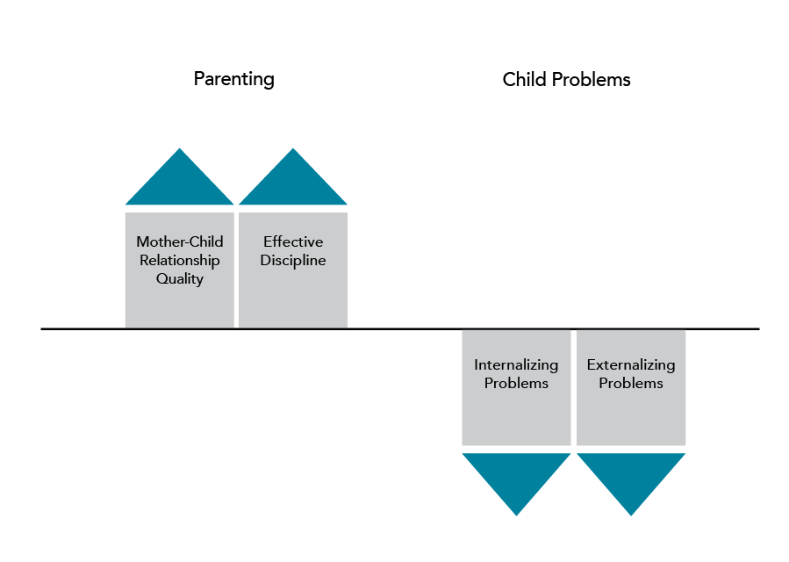
Results of Second Trial: Post-test
But no effect to reduce interparental conflict

Slide 10
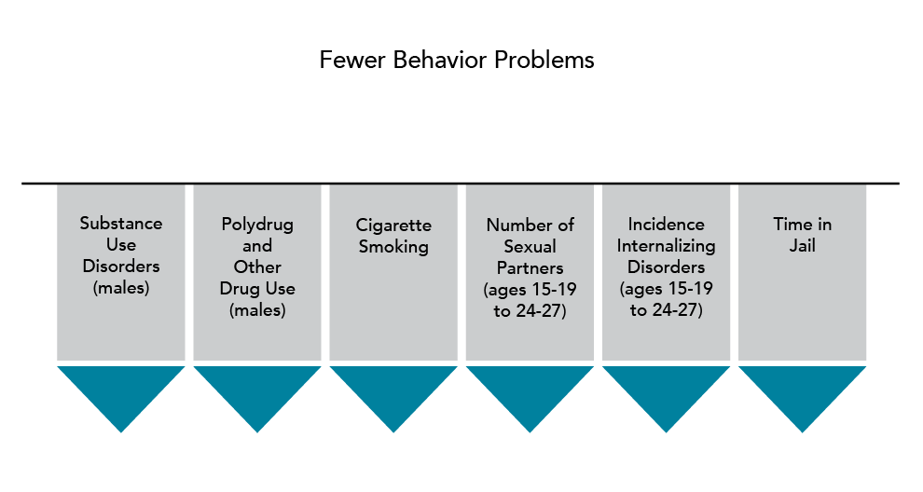
6 and 15-year Follow-up Results (age 24-27)
Lower Levels of Serious Behavior and Legal Problems
Cost Benefit – Cost =
Saving of $1077 per family

Slide 11
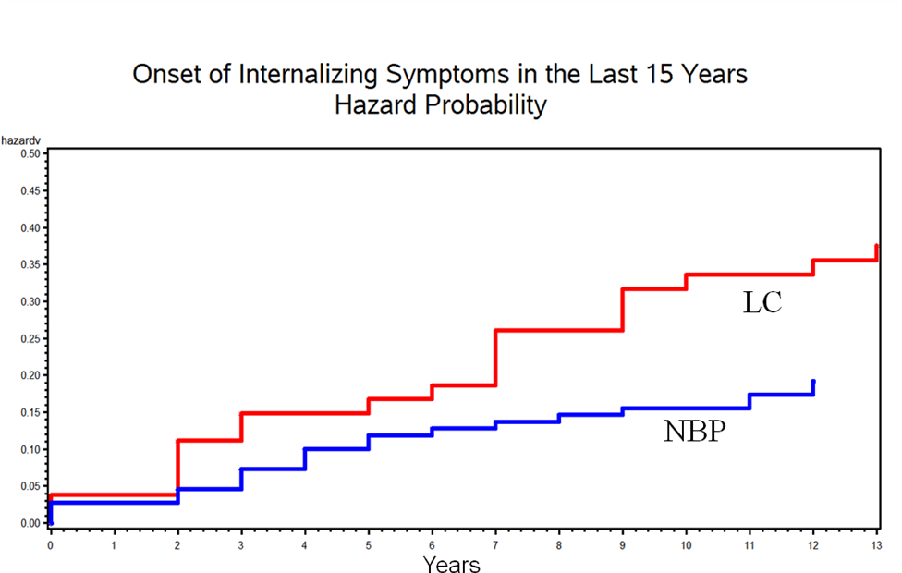
Example of Long-Term Effects of NBP:
Reduced Child Internalizing Disorders (Depression) 15 Years Later

Slide 12
Although NBP is Highly Effective: Many Barriers to Use By Divorced/Separated Parents
Cost to parents
- travel, childcare, time
Low engagement
- When offered to families for free – although 45% expressed an interest in NBP, only 10% signed up and 24% of them did not attend a single session
Expensive
- even group programs can be very expensive ($600 to $700 per family for a 10-session program)

Slide 13
Goal of Online eNBP To deliver all components of in-person NBP in a easily accessible and inexpensive format
Retain all components of in-person NBP
Enhance components to reduce interparental conflict
Easily accessible to parents on any device
30-minute sessions (10 or 6 session versions)
One session per week
Highly engaging format
Active learning
Practice of skills
Check in on use of program skills
Problem solving of problems with using skills

Slide 14
Skills for Each Component
Motivation: About You
And Your Children
Identify your goals
Divorce-related changes
Family Cycles
Family Time
One-on-One Time
Catch ‘em Doing Good
Big Ears
Summary Responses
Feeling Response
Protect Children from Conflict
De-escalate Conflict Turn Down the Heat
My Conflict Check-up Plan
Counting Misbehaviors
Wise Consequences
Change Plan
Increase positive cycle
Active Listening
Reduce Interparental Conflict
Effective Discipline

Slide 15
How We Teach Online
How to keep it up: Support Skill Use
Check in - How did it go?
Reinforce success
Tips for problems
Text reminders
How to Practice It: Home Practice
Anticipate barriers
Practical tips
Use the tool
Text reminders
How to do it: Teach the Skill
Brief description
Modeling use of skill
Interactive practice
Why this skill?
Benefits
Testimonials
Link to goal

Slide 16
Example of eNBP Component: Skills to Reduce Interparental Conflict
Selected strategies from 2 in-person programs that had reported some success in reducing interparental conflict
New Beginnings Program (NBP)
Dads for Life Program (DFL)
Both programs had a skills-based approach – eNBP taught skills from both programs
Motivate parents by focusing on harm to child
Teach parents specific skills to reduce conflict
NBP taught skills to keep the children out of the middle
DFL taught skills to reduce conflict escalation – “turn down the heat”

Slide 17
Parents learn skills they can control to protect their children from conflict: Their “Protective Shield”

Slide 18
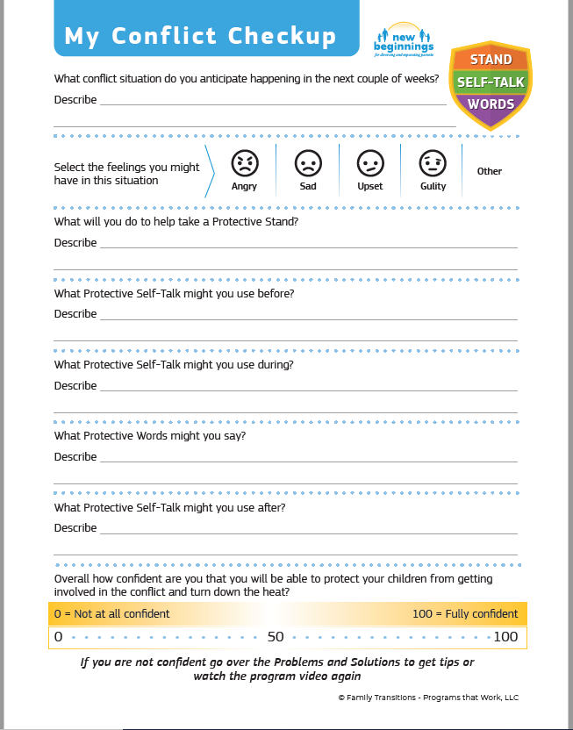
My Conflict Checkup:
Used to anticipate conflict and use their protective shield to protect their children

Slide 19
Reducing Interparental Conflict: Watch Teaching and Modeling

Slide 20
Reducing Escalation of conflict by “Turning Down the Heat”
Skills adapted from Dads For Life
Conflict de-escalation skills (Turn down the heat)
Protective Stand
Protective Self-talk
Protective Words
Avoid words and nonverbal behavior that escalate conflict
Use words that show respect (even if you don’t feel respect)
Get support from others (Find listening ears)

Slide 21
Can eNBP Obtain Comparable Benefits to In-Person NBP? Evaluation Using a Randomized Controlled Trial (RCT) Wolchik et al., (2022), Family Court Review
Recruited 131 parents online
Inclusion criteria: divorced, separated but never married, divorcing, or separating; had one or more children aged 6 to 18
Randomly assigned:
- 80 to eNBP
- 51 to wait-list control

Slide 22
Characteristics of the Sample
Average Age
Parents: 41 years old (SD = 8)
Children: 13 years old (SD = 3)

Slide 23
Characteristics of the Sample
Income Range:
$10,000 – $175,000
(Median = $30,001 - $40,000)

Slide 24
Reliable and valid measures
Interparental conflict (and youth caught in the middle)
Parental acceptance, rejection, open communication
Effective discipline
Child internalizing and externalizing problems
Child prosocial behavior
Assessment
Child and Parent Report
Pre and Post Program

Slide 25
Attendance: Comparison of eNBP with In-Person NBP
 | Online eNew Beginnings | In-person Group New Beginnings
% who signed up but did not attend a single unit/session | 27% | 25%
Of those who attended at least 1 meeting, % who attended all 10 meetings | 60% | 16%

Slide 26
Effects to Reduce Interparental Conflict
Only program to demonstrate efficacy to reduce both child report and parent report of conflict
Children did not receive the program
More effective for those with high conflict
Measure | Parent Report | Child Report | Who Benefits Most?
Interparental Conflict (CPIC) | Significant p> .05 | Significant p>.05 | Largest effects for those with high baseline conflict
Caught in the Middle | - | NS

Slide 27
Effects to Strengthen Quality of Parenting
Reports by both parent and child increase confidence in program effects
Measure | Parent Report | Child Report | Who Benefits Most?
Acceptance | ns | ns
Rejection | Significant p<.01 | Significant p<.05 | Higher baseline (parent report)
Consistent Discipline | Significant p<.01 | Significant p<.05 | Girls (child report)
Communication | Significant p<.05 | -
Follow-through | Significant p<.05 | Significant p<.01 | Lower baseline (child report)
Monitoring | ns | ns

Slide 28
Effects to Reduce Child Mental Health Problems
Significant effects by both parent and child raters gives us more confidence in the findings
Measure | Parent Report | Child Report | Who benefits most?
Internalizing Problems | Significant p<.01 | Significant p<.01
Externalizing Problems | NS | Significant p<.01 | Girls (child report)
Prosocial Behavior | NS | NS

Slide 29
Comparison of eNBP with In- Person NBP
eNBP has stronger effects at posttest
on (1) interparental conflict, (2) parenting, and (3) child mental health problems
eNBP has better attendance
better completion rate 59.6% vs. 15.9% of those who complete one session
eNBP is much less expensive and more accessible - $49 - $89 vs. $600 - $700

Slide 30
Acceptability to the Public: Parents Seem to Really Like eNBP: What did you like best about the program?
“I really liked the entire program helped me understand a lot of different things of my relationship between myself and my husband…”
“It helped me really invest in time with my child and helped me understand how to communicate with him better”
“It offered progressive solutions to everyday problems you no doubt will encounter during the coparenting process and evolution”
“…it got me and children closer to each other.”

Slide 31
What would you change about the program?
45% say Nothing….e.g. …”it was exactly what I need”; “it was wonderful” “…it should be mandated in all 50 states”
Some actual suggestions for change: “Make it shorter”; “A place to explain any special challenges a parent has”; “change the videos and make them more detailed” “…it would be helpful to have activities where both parents were present”

Slide 32
Limitations of the RCT of eNew Beginnings
Low power to detect other moderators such as ethnicity, parent gender
Sample primarily white non-Hispanic; lower-middle class
Only tested at post-test – no follow-up assessment
Sample recruited online rather than through the courts
Needs replication by other investigators

Slide 33
Summary of the Scientific Evidence
In-person NBP successfully translated into an online program
eNBP had significant effects to reduce interparental conflict, promote positive parenting, improve effective discipline and reduce child behavior problems – outcomes that are of significant interest to those working with divorced/separated families.
Strongest evidence in the literature of efficacy of an online parent education program for divorced families.
Extends prior evidence of the effectiveness of online programs with other populations to promote effective parenting

Slide 34
Topic for Discussion: How can we (eNBP) collaborate with you?
How can eNBP help you and the families you see?
We can provide an evidence-based parenting program for divorced/separating families that supports better outcomes for children.
Is easy to access and navigate, depicts real life scenarios that are relevant, teaches and builds upon skills weekly, provides feedback and suggestions for tough situations, provides valuable pasrent study/resource/reference materials and requires passing a knowledge-based quiz to receive completion certificate.
By providing resource materials for your practice.
Brochure describing the program, parent information sheet, outline of course, executive summary for colleagues

Slide 35
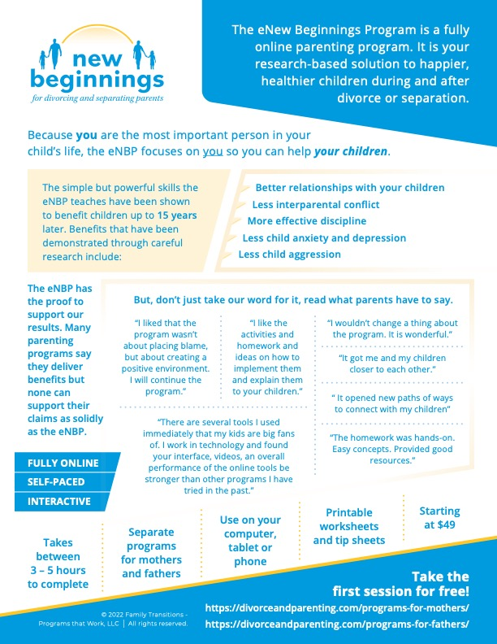
For parents to see the benefits of the eNBP for their children

Slide 36
How can you get access to the eNBP to learn how it can be useful to your families?
We give unlimited access to the 6-week program for two weeks to check it out and see how the eNBP will look, feel and work for your families
How do we do this?
Email me (Michele) at michele@divorceandparenting.com or call me at 480.203.7550 to request guest access
I will provide you with instructions to access the program via email
Irwin and I will answer any questions that you may have after reviewing the eNBP (Irwin.Sandler@asu.edu; michele@divorceandparenting.com )

Slide 37
How can you refer parents to the eNBP?
Parents who need a certificate for court compliance must enroll in the 6-week program. This program is completed one unit per week. The program includes instruction about and modeling of the skills, interactive exercises and practice of the skills.
Accountability for completing the program is provided by parents passing a comprehensive quiz at the end of the program demonstrating an understanding of the content of the program.
When the parent passes the quiz, they will receive a Certificate of Completion that can be presented to the court.
Parents can access the program by going to the website www.divorceandparenting.com and simply click on the Enroll Now button at the top of the home page. This will take the parent to the choice of either the Father or the Mother 6-week program.

Slide 38
References
Boring, J., L., Sandler, I. N., Tein, J. Y., Horan, J. J., & Velez, C. E. (2015). Children of Divorce-Coping with Divorce: A randomized control trial of an online prevention program for youth experiencing parental divorce. (2015). Journal of Consulting and Clinical Psychology, 83, 999-1005.
Grych, J. H., Seid, M., & Fincham, F. D. (1992). Assessing Marital Conflict from the Child's Perspective: The Children's Perception of Interparental Conflict Scale. Child Development, 63, 558-572.
Sandler, I., Ingram, A., Wolchik, S., Tein, J-Y. & Winslow, E. (2015). Long-term effects of parenting-focused preventive interventions to promote resilience of children and adolescents. Child Development Perspectives, 9, 164-171. Doi: 10.1111/cdep.12126
Sandler, I., Wolchik, S., Mazza, G., Gunn, H., Tein, J-Y, Berkel, C., Jones, S., & Porter, M. (2020) Randomized Effectiveness Trial of the New Beginnings Program for Divorced Families with Children and Adolescents, Journal of Clinical Child & Adolescent Psychology, 49:1, 60-78, DOI: 10.1080/15374416.2018.1540008
Wolchik, S. A., Sandler, I. N., Tein, J.-Y., Mahrer, N. E., Millsap, R. E., Winslow, E., & Reed, A. (2013). Fifteen year follow-up of a randomized trial of a preventive intervention for divorced families: Effects on mental health and substance use outcomes in young adulthood. Journal of Clinical and Consulting Psychology, 81,600–673. doi:10.1037/a0033235
Wolchik, S., Sandler, I. Winslow, E., Porter, M., & Tein, J-Y. (in press). Effects of a Web-based Parenting After Divorce Program to Reduce Interparental Conflict, Increase Quality of Parenting and Reduce Children’s Post-Divorce Behavior Problems

